Slide 1

Time Series Forecasting Platform
(Brent Crude Oil)
Akil Mohamed Firos
Student id - 219015127
MSc AI for Business Intelligence
Academic Supervisor - Andrew Morozov
Sprint 1.2 Data Preprocessing and Exploratory Analysis

Slide 2
Sprint Objective/Contents
The objective of Sprint 1.2 was to transform the raw multi-source market data into a clean, consistent, and model-ready dataset for Brent crude oil forecasting.
This sprint focused on:
  Cleaning raw Brent, WTI, DXY, VIX, and OPEC+ data
  Aligning different data frequencies into weekly observations
  Handling missing values caused by market holidays and monthly OPEC+ data
  Running initial descriptive and correlation analysis
  Testing normalisation and smoothing techniques before model development

Slide 3
Raw Data Challenge: Different Frequencies
The dataset combines financial market variables and supply-side production data. The main issue is that these variables are not recorded at the same frequency.
To solve this, all variables were converted into a common weekly Friday-close frequency.
Variable | Original Frequency | Source | Issue
Brent crude | Daily | Yahoo Finance | Trading days only
WTI crude | Daily | Yahoo Finance | Trading days only
US Dollar Index | Daily | Yahoo Finance | Trading days only
VIX Index | Daily | Yahoo Finance | Trading days only
OPEC+ production | Monthly | EIA API | Lower frequency than market data
Daily market dataset
Weekly Friday close
Monthly OPEC+ dataset
Forward-filled weekly value
Master weekly dataset

Slide 4
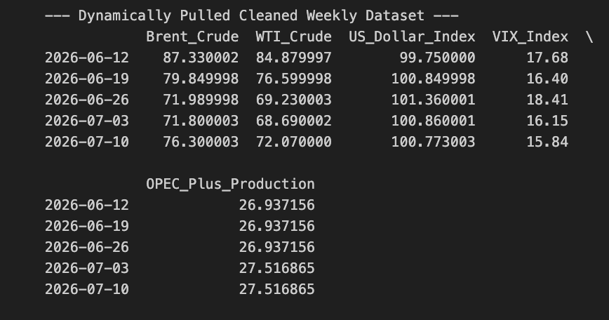
Data Cleaning Pipeline
The cleaning process created a single weekly dataset suitable for time-series modelling.
Main steps:
  Download raw market data from Yahoo Finance
  Extract closing prices for Brent, WTI, DXY, and VIX
  Resample daily market data to weekly Friday close
  Pull OPEC+ production data from the EIA API
  Convert monthly OPEC+ data into datetime format
  Merge market and supply data using the date index
  Forward-fill monthly OPEC+ values
  Drop remaining missing Brent observations
Raw APIs
Date Formatting
Weekly Resampling
Missing Value handling
Merged master dataset

Slide 5
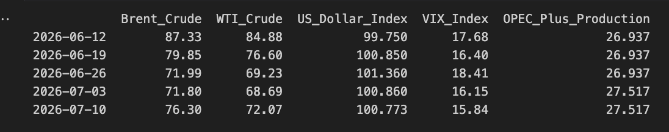
Final Model-Ready Dataset
After preprocessing, the final dataset contains one row per week and combines the target variable with external market drivers.
The final dataset is now aligned at a weekly frequency, which makes it usable for SARIMAX, Random Forest, XGBoost, LASSO, and LSTM models.
Column | Meaning | Role
Brent_Crude | Brent crude oil price | Forecast target
WTI_Crude | US crude oil benchmark | Competitor / spread signal
US_Dollar_Index | US dollar strength | Currency driver
VIX_Index | Market volatility index | Risk sentiment proxy
OPEC_Plus_Production | OPEC+ output volume | Supply-side driver

Slide 6
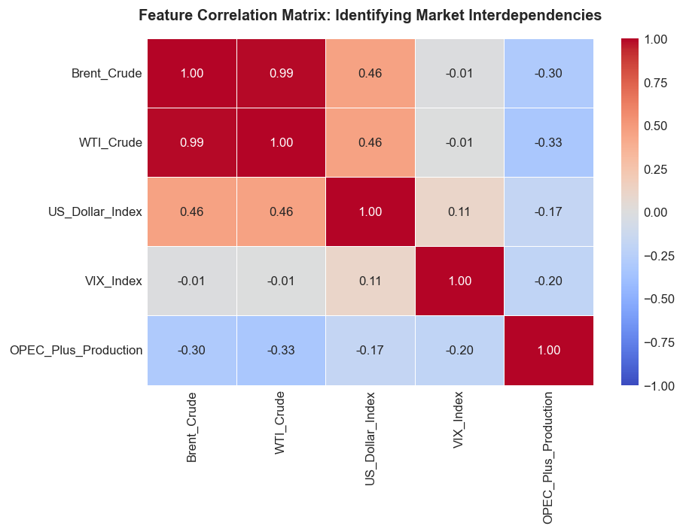
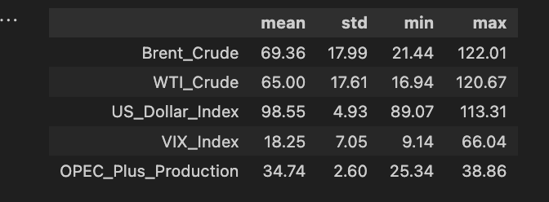
Initial EDA: Statistics and Correlation
The exploratory analysis was used to understand the scale, volatility, and relationships between the features.
Key observations:
  Brent and WTI are extremely highly correlated, around 0.99
  Brent reached a maximum of around 122, showing major price spikes
  VIX reached a maximum of around 66, capturing crisis-level market stress
  OPEC+ production is less volatile because monthly values were forward-filled
  Correlation gives an initial view, but it does not prove causality
Summary table for the statistics limited to only mean, standard deviation, min and max
Causation - a change in one variable directly produces a change in another, creating a cause-and-effect relationship.

Slide 7
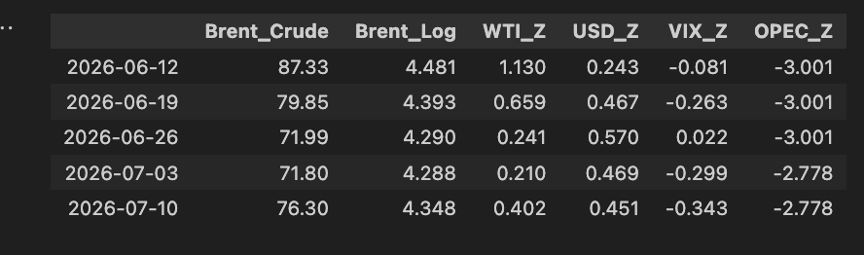
Normalisation Methods
Normalization was applied because the variables are measured on different scales.
Without scaling, models may overvalue variables simply because they have larger numerical values.
Methods applied:
Method | Applied To | Purpose
Log transform | Brent crude | Reduces large price-scale effects/spikes
Z-score scaling | WTI, DXY, VIX, OPEC+ | Places variables on comparable scale to its own mean and std
Raw columns retained | All variables | Allows comparison with original data
The transformed dataset is more suitable for scale-sensitive models such as LASSO, SARIMAX, and LSTM.
The table for the transformed columns

Slide 8
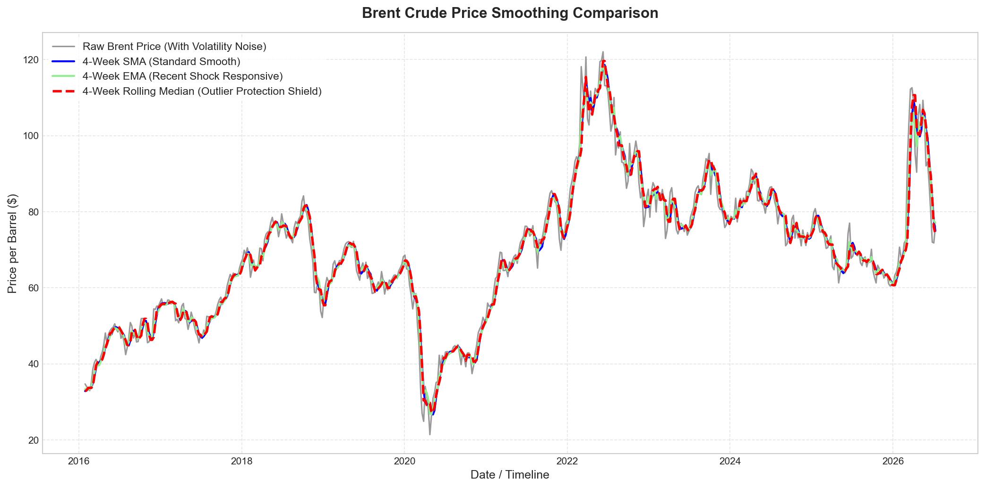
Brent Crude Price Smoothing Comparison
Smoothing was tested to separate the underlying Brent price trend from short-term volatility.
Three smoothing methods were applied:
The EMA is more responsive to sudden price changes, while the rolling median is more robust against temporary spikes.
The point of this is not to predict anything yet but instead to understand how different smoothing methods change the Brent price signal before feature engineering and model training.
Method | Purpose
4-week SMA | Simple trend smoothing
4-week EMA | Reacts faster to recent market shocks
4-week rolling median | Reduces the effect of outliers
The chart will be seen much clearer in the next slide

